Slide 1

The Pacific Northwest and the Arctic Indians
Lesson 4

Slide 2
River Traders
In the Northwest there was little agriculture.
Instead there were many fish, deer and other animals.
The true staple is seafood.
These Indians were hunters/gatherers and they used trees in the forests to make boats, houses and tools.
Indians used the rivers in the Northwest to trade goods.

Slide 3
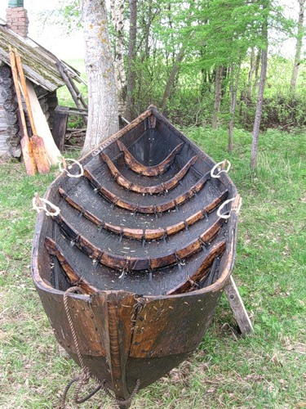
Dugout

Slide 4
The Chinook Tribe
The Chinooks were a tribe that are known for their trading.
They developed a language for trading so that all Indian tribes could understand the business.
The Chinooks traded fish, shells, furs, oil, boats, masks and jewelry.
Their villages were homes made of rows of long wooden houses with no windows. This is called a pit house.

Slide 5
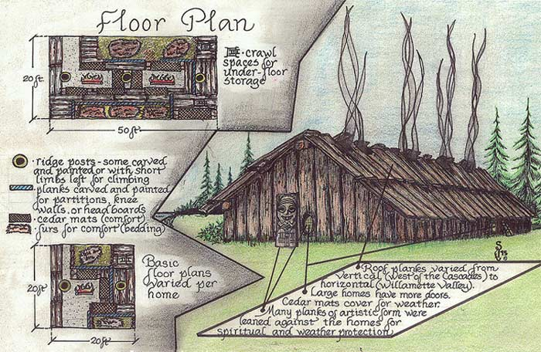

Slide 6
Makahs Tribe
Makahs were coastal people (they lived by the ocean) and hunted whales at sea.
They made spears and went to sea in their wooden boats to hunt whales for food and oil.
The Makahs lived in wooden houses along the shore.

Slide 7
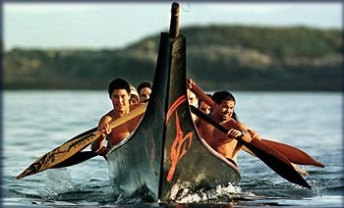

Slide 8
Kwakiutl Tribe
Kwakiutls lived near the Pacific Ocean.
This tribe only captured whales if the whales washed up on shore. They did not hunt them.
They fished.
The Kwakiutls also lived in wooden homes on the shore.
The Kwakiutls were some of the best woodcarvers. They made totem poles.
Totem poles are wood carvings that
show a family’s history.

Slide 9
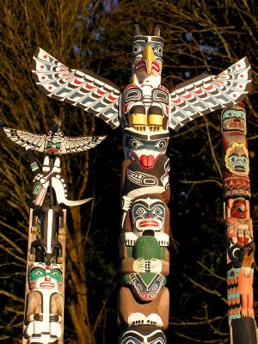
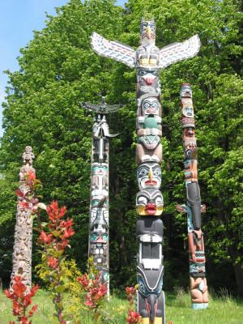

Slide 10
The Inuit Tribe
The Inuit lived in the Arctic. The land was a frozen tundra.
It was too cold to farm so these people got most of their food and shelter from animals they hunted like seal, walrus, and caribou.
Some Inuit built igloos to live in and others made tents made of thick animal skin.

Slide 11
